Slide 1
SARVP FINANCE CORPORATE PROFILE
WELCOME TO SARVP FINANCIAL SERVICES PVT LTD
Notes:
Click to add notes
This template is copyright of Presentation Magazine. www.presentationmagazine.com

Slide 2
ABOUT SARVP FINANCE
Registered in Varanasi as a non-banking financial company , SARVP Financial Services Private Limited is a lending company.
SARVPFinance is a trusted finance company that offers a range of products to customers. The company is committed to providing innovative and personalized financial solutions to help customers meet their financial goals.
SARVP Finance offers a low-cost, easy-to-understand, no-nonsense, flexible, and convenient financial solution for business owners, individuals, couples, and families. SARVP Finance helps its clients achieve their financial goals and strives to make them happy.
Notes:
Click to add notes
This template is copyright of Presentation Magazine. www.presentationmagazine.com

Slide 3
The management of Varanasi-based SARVP FINANCIAL SERVICES PRIVATE LIMITED includes SHASHI PAL GAUTAM, ROHAN SINGH, VINAY KUMAR SHARMA, and ANUJ KUMAR SHARMA.
We are a team of experts with years of experience in the finance industry and are here to provide the best service possible for you. We offer top-notch solutions to all your financial needs.
We deal in unsecured business loans, working capital, and micro loans.
The company provides financial services in the fields of insurance, loans, and investments. The company has branches across 4 states and it has a high customer satisfaction rating.

Slide 4
GOALS AND VALUES
Core Purpose -
To transform people’s mindset to grow and enable them to dream big by providing confidence and creativity
Core Values -
Discipline
Integrity
Transparency
Customer Value
Accountability
Quest for Excellence

Slide 5
OUR PROCESS
LOGIN
GENERATE CIBIL
PERSONAL DISCUSSION
VERIFICATION
LOAN AGREEMENT
E NACH VALIDATION
WELCOME CALL AND DISBURSMENT

Slide 6



OUR PRODUCTS

Slide 7
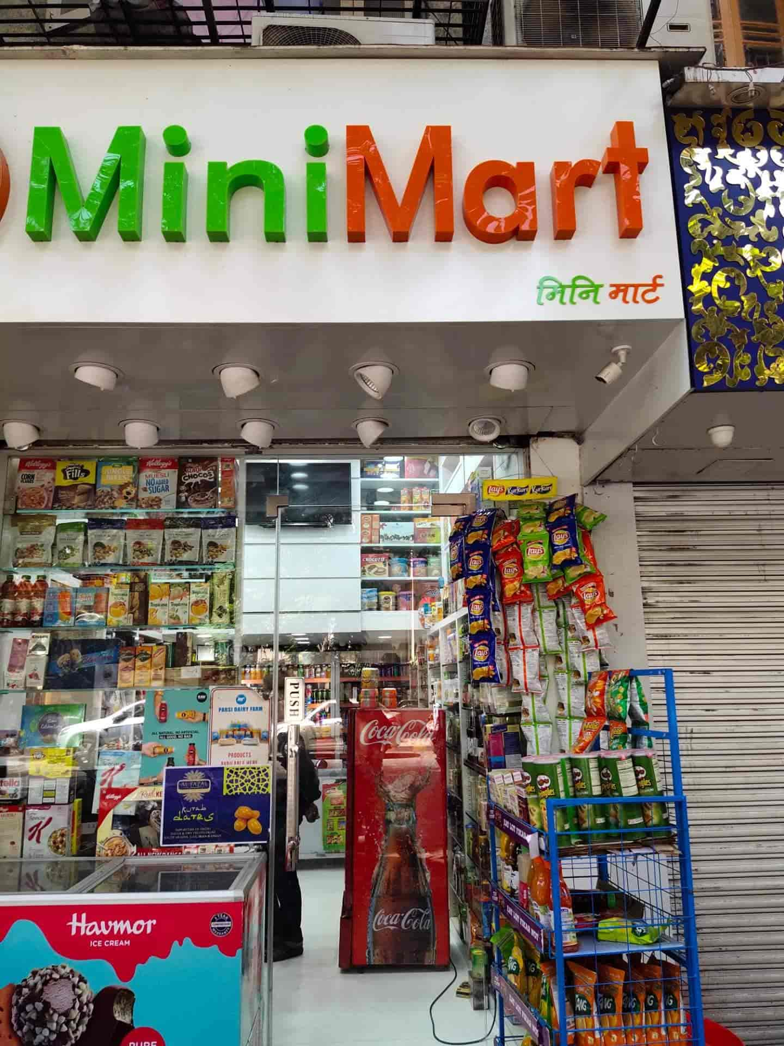
PRODUCT FEATURES
1.UNSECURED BUSINESSLOAN
Business Loans or Unsecured Small business loans are available at an attractive rate of interest, and you can use the funds for a wide range of business-related purposes.
ZZZZ
AGE | 21 to 60
BUSINESS VINTAGE | Minimum 1.5 years
LOAN AMOUNT | 75000 to 10,00,000
LOAN TENURE | Upto 18 months
OWNERSHIP | Either shop or residence owned

Slide 8

2. MICROLOANS
Microloans are types of small finance or business loan of the smaller amount offered to micro-entrepreneurs or low-income group families who have little or no access to financial or lending institutions.
AGE | 21 to 50
BUSINESS VINTAGE | Minimum 1 year
LOAN AMOUNT | 25000 to 75,000
LOAN TENURE | Upto 6 months
OWNERSHIP | Either shop or residence owned

Slide 9

3. WORKING CAPITAL LOAN
A working capital loan helps you in running everyday operations. These loans usually cover recurring expenses such as accounts payable, wages, etc. Our working capital loans help offset your working expenses during a low sales / revenue period.
AGE | 21 TO 60
BUSINESS VINTAGE | Minimum 1 year
LOAN AMOUNT | 100000 to 600000
LOAN TENURE | Upto 18 months
OWNERSHIP | Either shop or residence owned

Slide 10
SERVING INDUSTRIES
Chemical
Pharmaceuticals
Plastic retailers/manufacturers
Resturants
Kirana stores
Electrical equipment and components
Electronics
Farm equipment
Printing and packaging
Cloth merchants

Slide 11
WHO CAN APPLY?
MSME/ NON INDIVIDUAL
Sole proprietors
Private Limited
Partnership firm
Limited liability partnership

Slide 12
WE PROVIDE LOAN BASED ON
Business turnover
GST
Bulk order
Current account statement
ITR
Cash flow assessment

Slide 13
OUR PRESENCE
VARANASI
GORAKHPUR
JAUNPUR
BILASPUR
PRAYAGRAJ
KOLKATA
VADODARA
AHMEDABAD

Slide 14
OUR LEADERS
Mrs Sonal shah( HR head)
Vinay kumar Sharma( legal head)
Roshan singh( collection head)
Mr Ashok Manocha( Advisory- ex banker with 25 years of experience in Banking and NBFC)

Slide 15
Thank you!

